Slide 1
Traffic light VHDL
JAICHANGPARK
2018-10-10

Slide 2
Internal
clock
Sequential
logic
State decoder
Output logic
led
Timing
circuit
Trigger logic

Slide 3
main
side

Slide 4
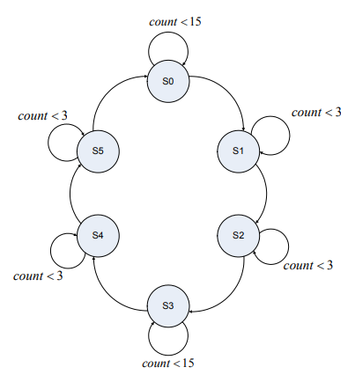
State | Main | side | delay
0 | G | R | 5
1 | Y | R | 1
2 | R | R | 1
3 | R | G | 5
4 | R | Y | 1
5 | R | R | 1

Slide 5
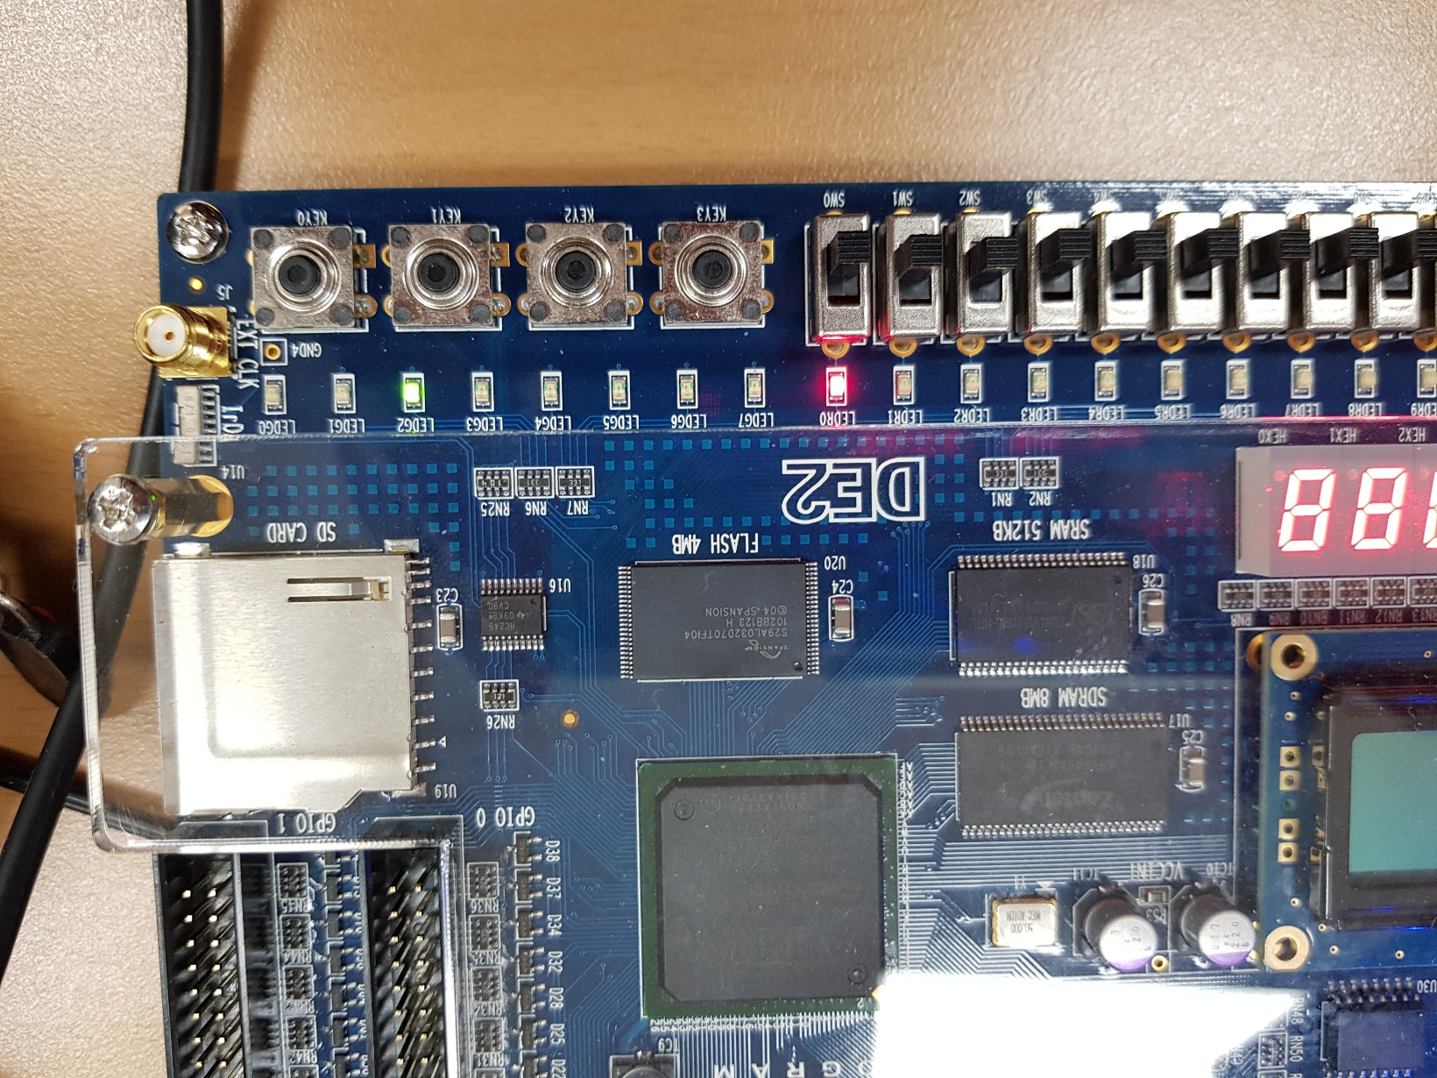
녹,주,빨
녹, 주 , 빨

Slide 6

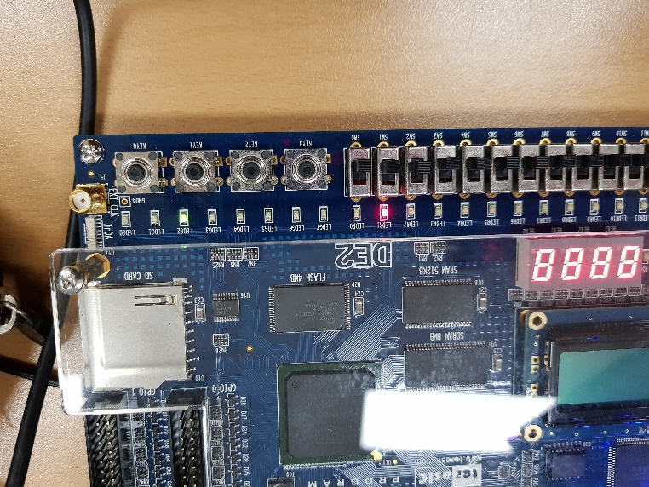
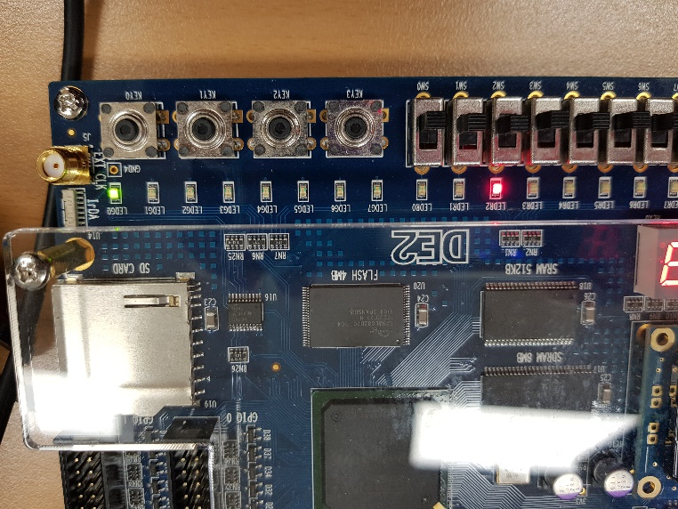
state0
state1
state2

Slide 7
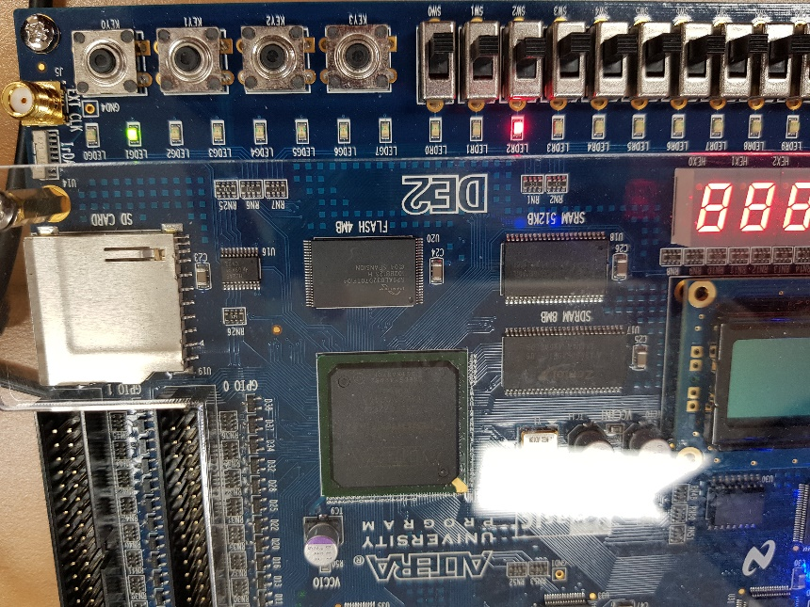
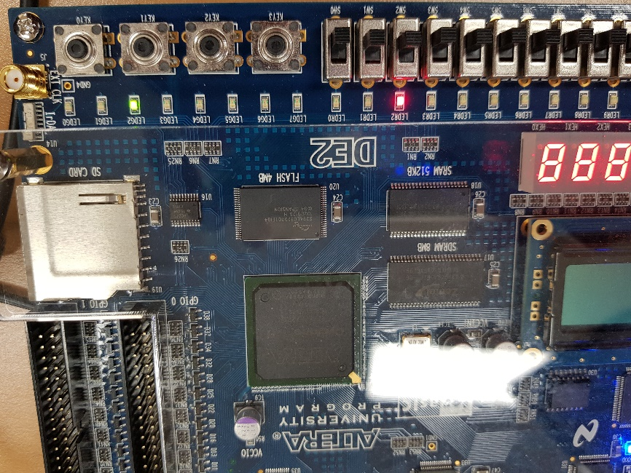
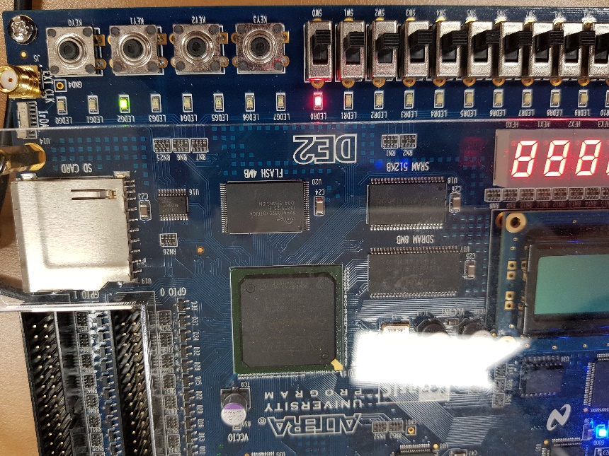
state3
state4
state5

